Slide 1



Created by:
Muhammad Chosasih Mahendra
mchosasih@gmail.com
linkedin.com/in/mchosasih/
Analyzing eCommerce Business Performance with SQL
Fresh graduate from IPB University majoring in Business and have an interest in the field of data analytics. Chosasih also has completed several data analytics projects and is a Data Science graduate from Rakamin Academy.
Click here to visit my portfolio.

Slide 2
Overview
Overview
In a company, measuring business performance is very important to track, monitor, and assess the success or failure of various business processes. Therefore, in this project, we will analyze business performance for an e-Commerce company.
Methodology
metrics
Data Preparation SQL
Data Visualization Excel
Tableau
Data Presentation PowerPoint
Customer Growth
Product Quality
Payment Types

Slide 3
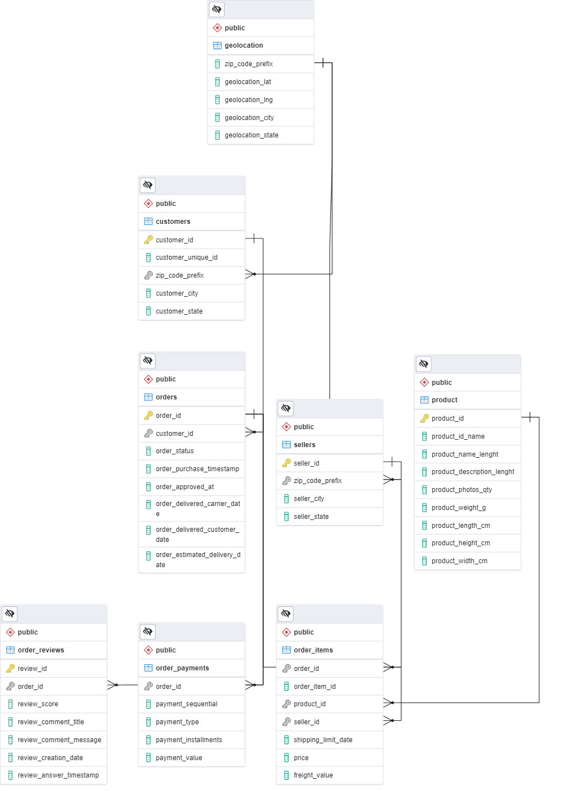
Data Preparation
Import data into database using PostgreSQL.
Rename and change datatypes that don't match the dataset.
Create Entity Relationship Diagrams (ERD) to facilitate analysis between datasets.
All datasets can be accessed here
See ERD illustration here
The ERD file (PostgreSQL) can be viewed here

Slide 4
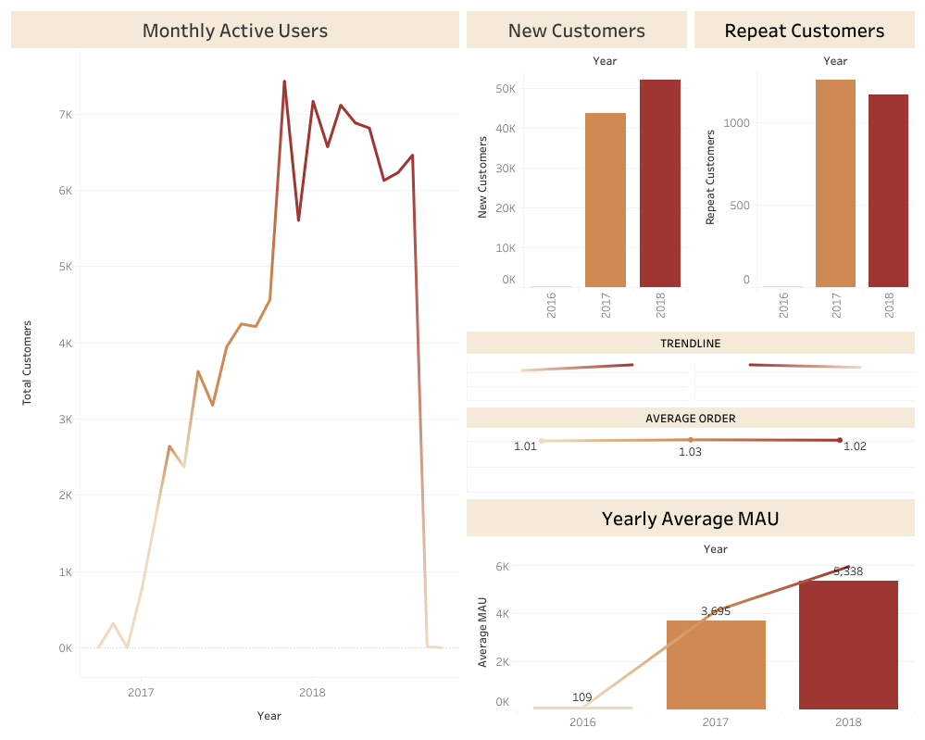
Annual customer activity growth
Average Monthly Active User has increased every year. However, there was a significant decline in the last two months (September – October 2018).
The number of new consumers increases every year, while consumers who make repeat orders tend to stagnate; this can be seen from the average order per user, which is only 1 order.
The peak of monthly active users was in Q4 2017.
See full query here
To access the dashboard, click here

Slide 5
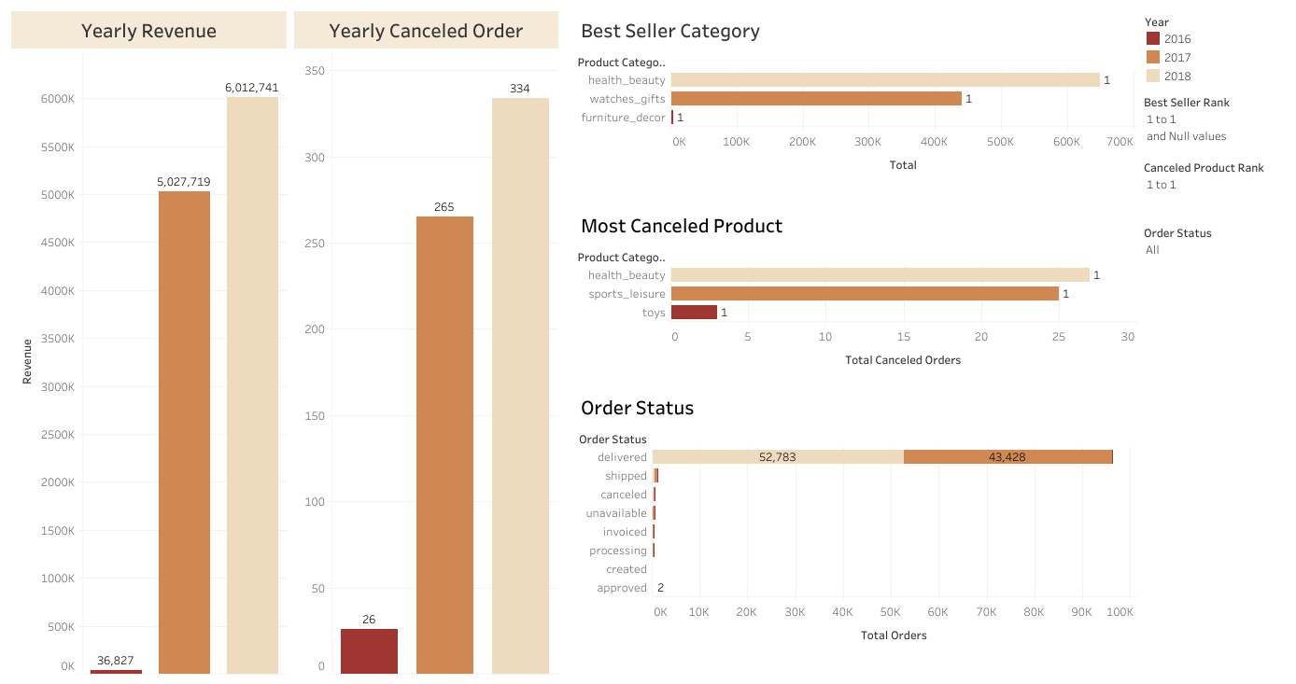
Annual product category quality
Revenue spiked up in 2017.
Canceled orders have small portions.
Watches gifts were the best-selling product in 2017 and were rarely canceled.
Health and Beauty is the most frequently purchased and most canceled product in 2018; further analysis is needed to determine the cause.
See full query here
To access the dashboard, click here

Slide 6
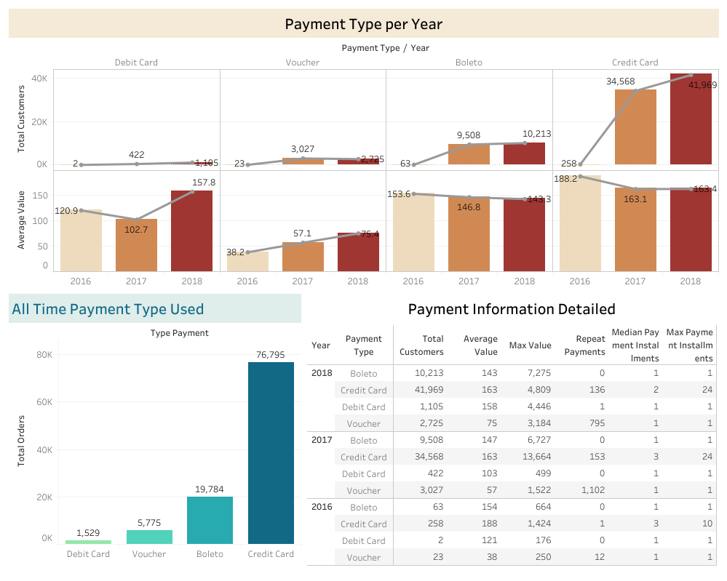
Annual payment type
Credit Card is the most used payment method, while Debit Card is the most growth payment method (161.85% increase).
Voucher is a payment method that used repeatedly, while Boleto is never used as a recurring payment method, while Debit Card is only used once.
Although the number of customers has increased, the average value per credit card or Boleto transaction has been stagnant.
Payments using credit cards tend to be in the form of installments.
There were high-value transactions using vouchers in 2018 (3,184).
See full query here
To access the dashboard, click here

Slide 7
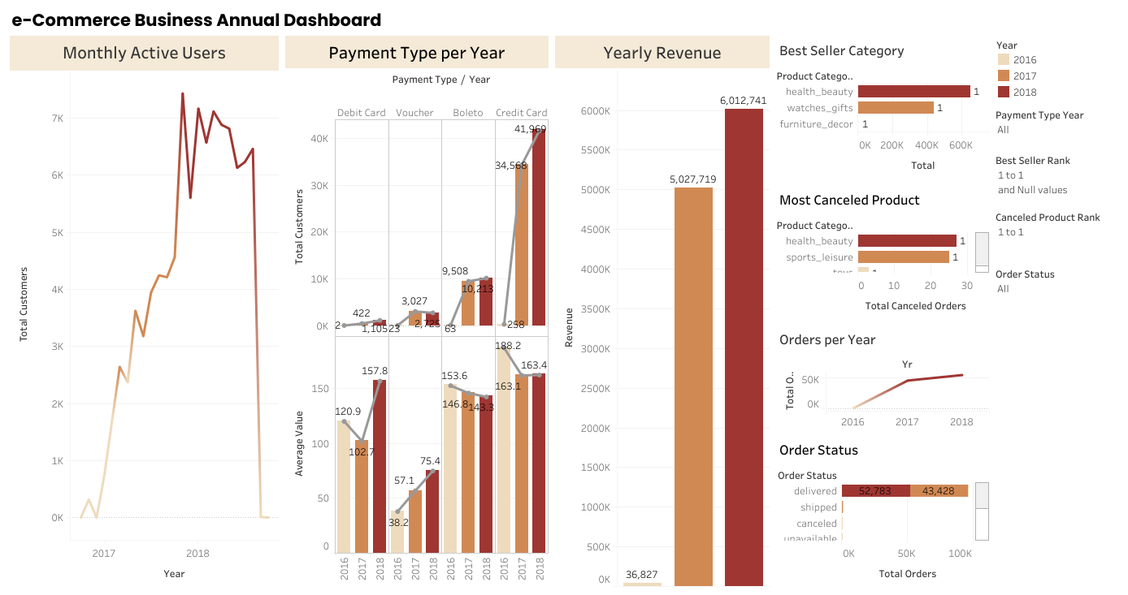
Final dashboard
To access the dashboard, click here

